Slide 1


Tell Me More®
for Covid-19 Care
Information & License
April 2020

Slide 2
Tell Me More® Freely Available
During Covid-19 Crisis
To support our audiences and partners, The Gold Foundation is making Tell Me More® available with no fees during the COVID-19 crisis. We continue to care deeply about the wellness of both practitioners and patients, and we hope this tool will help you during this urgent time.
Thank you for connecting with patients.
We are grateful for your compassion, care, and courage in this pandemic and always

Slide 3
About The Arnold P. Gold Foundation
We are a nonprofit organization founded in 1988 by Dr. Arnold P. Gold, a pediatric neurologist at Columbia, and based in Englewood Cliffs, New Jersey. For more than 30 years, we have championed the human connection in healthcare.
Your medical institution or affiliated medical or nursing school may already have a Gold Foundation program in place, such as a White Coat Ceremony and a chapter of the Gold Humanism Honor Society, or be a member of our Gold Partners Council, a group of schools and health systems that passionately share our mission of humanism in healthcare.
Thank you for using Tell Me More® to strengthening the human connection in this crisis, for both your patients and your whole health team.

Slide 4
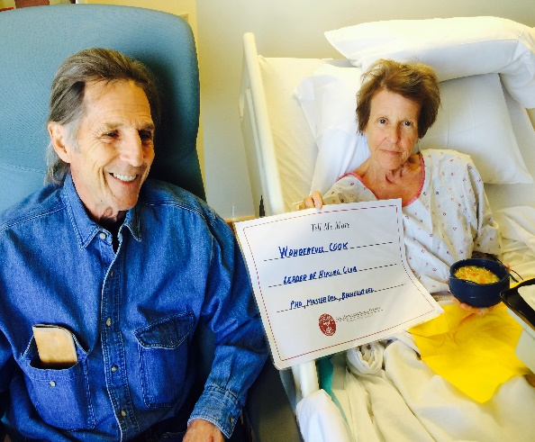
Why use Tell Me More®?
A simple, powerful way for patients to connect with their care team
A short, engaged conversation with a patient or family member yields a wall poster with personal information that they want their care team to know.
The patient feels seen and/or is recognized as a unique person.
Health care team members see the patient as a unique person and now have potential points of connection.
During COVID-19, isolation is a particular concern. Tell Me More® could be paired with notes/drawings from family members.
Notes:
Please use these pages to get stakeholder buy in and quickly deploy

Slide 5
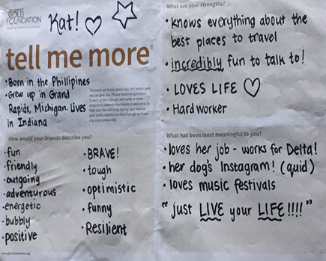
Benefit to Patients
“I felt like I was treated like a person, and not just as a patient.”
“That poster hanging there gives me hope.”
A chance for patient who cannot speak to still “tell” something about themselves .
Notes:
Please use these pages to get stakeholder buy in and quickly deploy

Slide 6
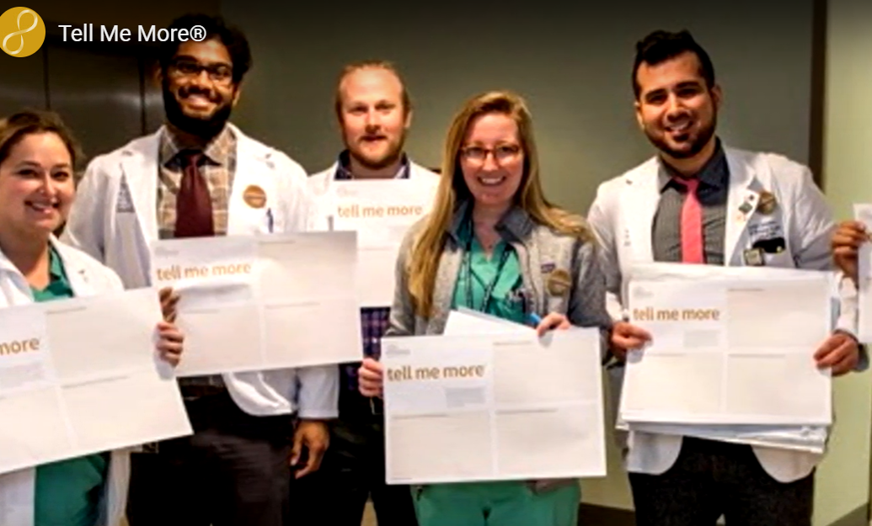
Benefit to Healthcare Professionals
“Gaining insight on a patient’s life outside the hospital makes it easier to form a connection with them.” - Hospitalist from NSUH
“One of our patients became very confused at night time. Having the [Tell Me More®] poster allowed us to better care for and reorient the patient.” - Nurse, Lenox Hill Hospital
Notes:
Please use these pages to get stakeholder buy in and quickly deploy

Slide 7
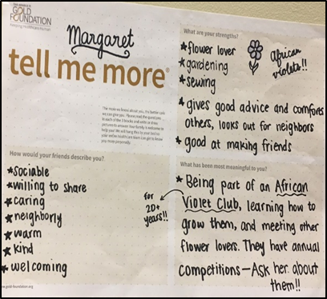
How Tell Me More® works
During the covid19 crisis healthcare settings may need to make modifications to the following process to accommodate unusual circumstances.
Engage the patient/family member: A member of the care team speaks with a patient or a family member to explain Tell Me More® and learn whether they would like to participate. The care team member can share the Tell Me More® Patient Handout and Permission Form, if your healthcare institution decided to use it.
Be sure that all patients and/or family members understand that this is a completely voluntary program.
Notes:
Please use these pages to get stakeholder buy in and quickly deploy

Slide 8
How Tell Me More® works
(2) Help fill out the wall poster/page: If a patient and/or family member is interested in participating, any member of the care team engages the patient and/or family member in filling out the three questions:
  What do you think is your greatest strength?
  How would your family and/or friends describe you?
  What has been most meaningful to you in your life?
The patient and/or family member is welcome to add more or different details. Double-check to make sure they are pleased with the page before it is hung.
Notes:
Please use these pages to get stakeholder buy in and quickly deploy

Slide 9
How Tell Me More® works
(3) Hang up the wall poster/page: Traditionally, the Tell Me More® poster/page is stuck or taped to a wall in a patient’s room. Given the need to be extra careful during the pandemic, the hospital team may choose to hang it outside the patient’s room in the window, facing into the room so that it is visible to the patient and any healthcare/ professionals in the room, or even in their chart.
Please do what is best during this time for safety and patient connection.
Notes:
Please use these pages to get stakeholder buy in and quickly deploy

Slide 10
How Tell Me More® works
If your institution is using our Permission Form, please save a signed copy in the patient’s chart.
Note: Hospitals are welcome to use a different way to acknowledge a patient’s agreement to participate in Tell Me More®. Our Permission Form is one option.
Notes:
Please use these pages to get stakeholder buy in and quickly deploy

Slide 11
Setting up Tell Me More® at your care setting
Stakeholder buy-in: Get any approvals from hospital leadership.
Your procedures: Decide on what works best for your hospital/organization:
  Which care team members will approach the patient and/or family member to ask about whether they’d like to participate and help fill out the page?
  Set up a procedure so a patient/family member who has declined won’t be accidentally asked repeatedly.
  Where and how will the page be hung?
  Will your organization use the Permission Form to capture the patient’s agreement to participate, or some other form? Will it be saved into the patient’s chart?
Training: Share this Tell Me More® presentation with those who will be engaging with patients to fill out the form, along with other guidance specific to your organization.
Communication: Share the Tell Me More® plan with the entire team through a clear memo and in any available communication methods already in place, such as a daily email or bulletin board.

Slide 12
How we will implement Tell Me More®
Please fill out and add to this slide based on your
hospital/organization’s procedure:
_________(ex: nurse, student, volunteer) will engage the patient/family member to explain Tell Me More® and ask about whether they’d like to participate, ensure they sign the Permission Form, and help fill out the page.
We will ensure a patient/family member who has declined won’t be accidentally asked repeatedly by ________________________________.
The page will be hung _______________________ .
The Permission Form will be saved into the patient’s chart by scanning/taking a photo/etc.

Slide 13
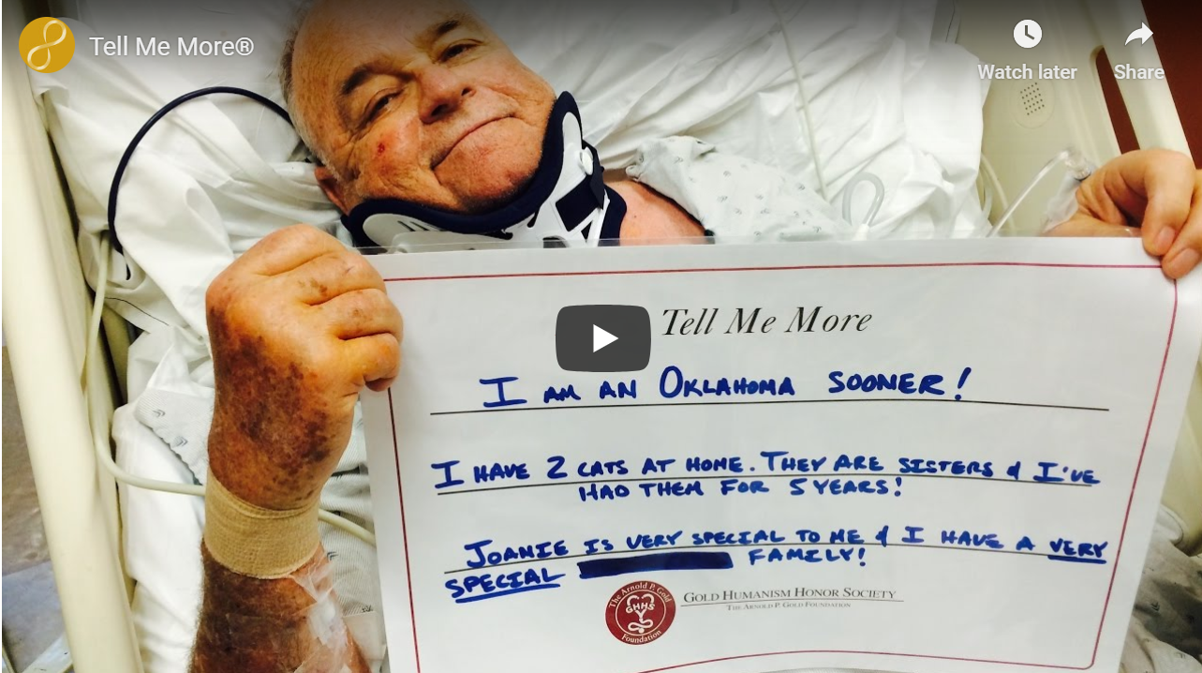

Online videos demonstrating
Tell Me More® in different settings
Overview of Tell Me More® program
www.gold-foundation.org/newsroom/video/tell-me-more
Tell Me More® in corporate settings:
https://www.gold-foundation.org/newsroom/video/quest-diagnostics-integrates-tell-me-more-into-their-everyday-excellence-program/

Slide 14
Tell Me More® Considerations
The Gold Foundation’s Tell Me More® program offers a strategy to anchor compassion and connection in every team-patient encounter. The program is designed to create mutual connections and to help us deepen the professional relationship, whether it’s between a patient and a healthcare professional or between co-workers.
Tell Me More® is a simple, brief, yet genuine way to humanize interactions with others. Tell Me More® enhances professionalism by building bridges between people, and a growing body of research shows how important that is: increased connection between patients and the healthcare team improves satisfaction and outcomes. We all feel better when we feel known, and those feelings translate into a better experience for patients, employees, and the whole team.
Since 2014, Tell Me More® has been implemented through projects and program licenses internationally. Each organization determines with us the method or combination of methods that work best within their care setting. It is flexible and offers benefits in hospitals and healthcare settings, as well as in corporate and community environments.
Tell Me More® Licenses are usually customized based on size and type of institution.
We would like to work with you to produce thought leadership/evidence on the effect of the program/outcomes. Please contact Pia Pyne Miller, MPH by email pmiller@gold-foundation.org to discuss thought leadership/evidence, as well as further details on a Full License.

Slide 15
We are here to help.
The Gold Foundation hopes Tell Me More® will be a useful tool for you during this COVID-19 crisis. Please reach out with any questions or ways that we can help.
Your feedback and suggestions for how we can improve and how you are using
Tell Me More® are very welcome. Please reach out to Pia Pyne Miller, MPH,
Senior Director – Strategy and Business Development, at 201-567-7999 or pmiller@gold-foundation.org discuss further details on implementing, on sharing pictures, or on more information about a full license.
Thank you for your humanistic care of patients. We are grateful for your compassion, care, and courage in this pandemic.
With deep gratitude,
The Gold Foundation Staff

