Slide 1

Gold Humanism Honor Society
2020 Virtual Induction

Slide 2
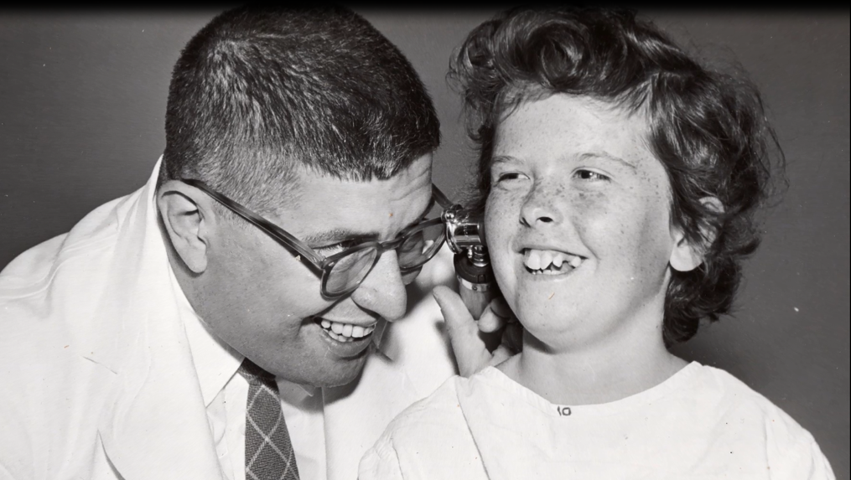
The Arnold P. Gold Foundation champions the human connection in healthcare

Slide 3
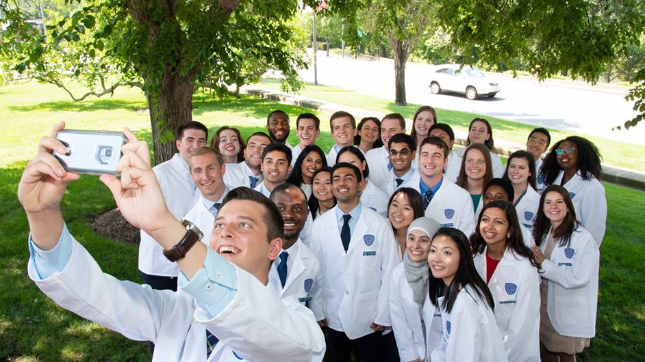
We engage schools, health systems, companies, and individual clinicians in the joy and meaning of humanistic medicine …

Slide 4
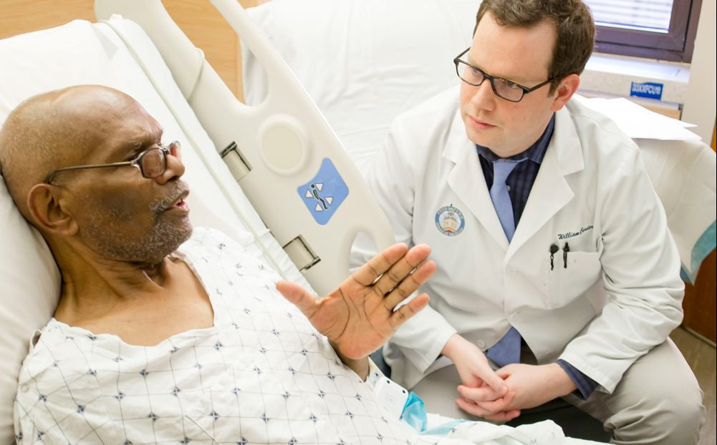
… so that patients and their families can be partners in
collaborative, compassionate and scientifically excellent care

Slide 5
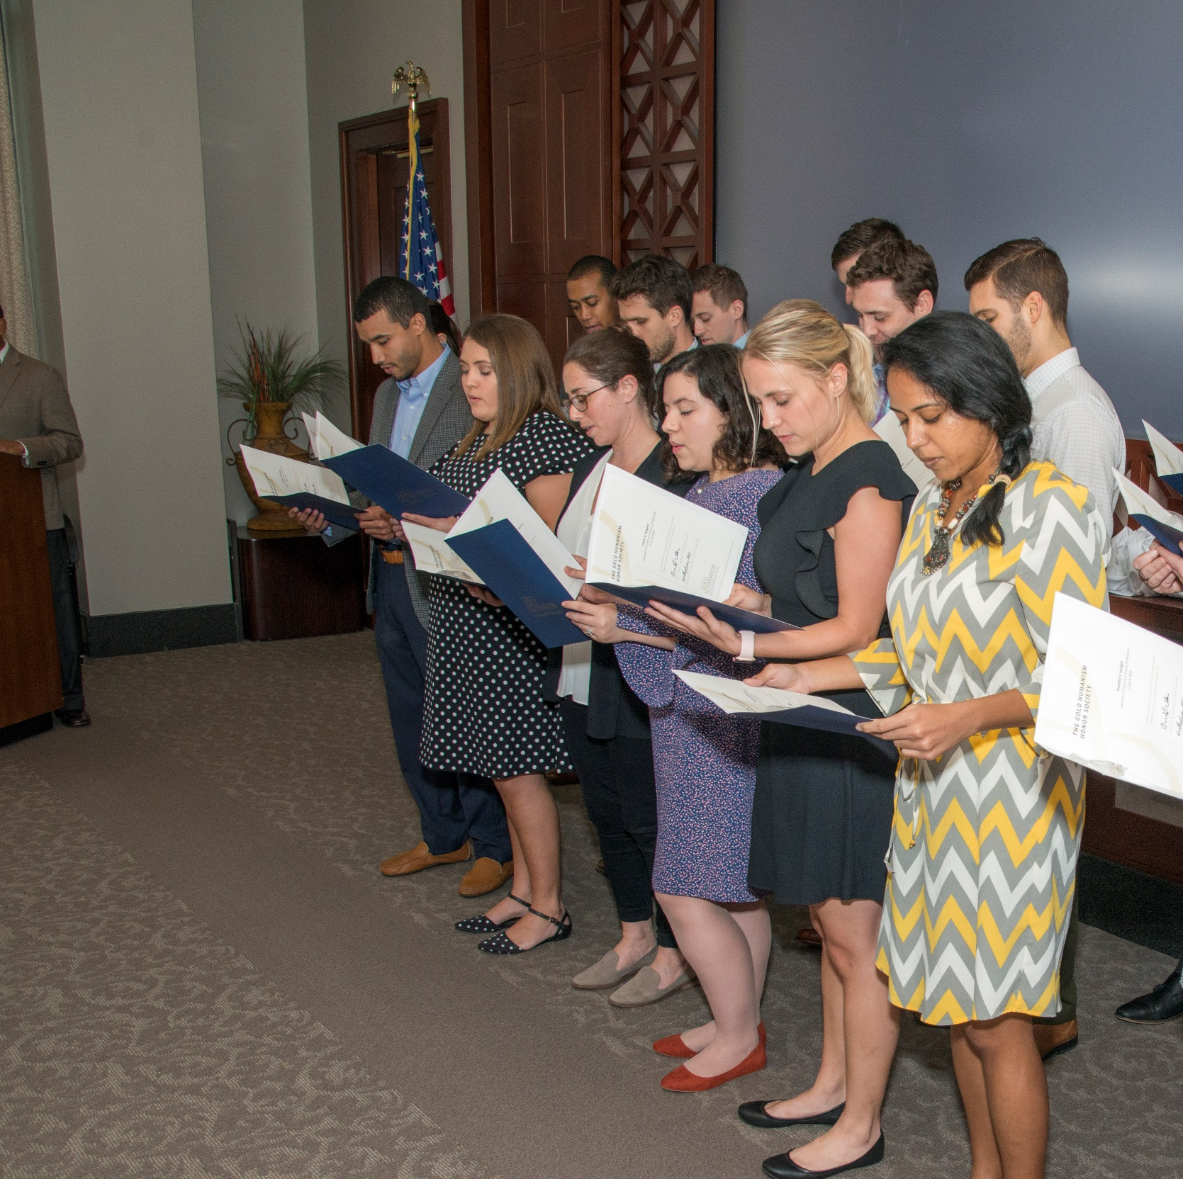

The Gold Humanism Honor Society
Established in 2002
Recognizes students, residents and faculty who are exemplars of compassionate patient care and who serve as role models, mentors, and leaders in medicine
Peer nominated
Began with 3 chapters, now have 160+ chapters

Slide 6
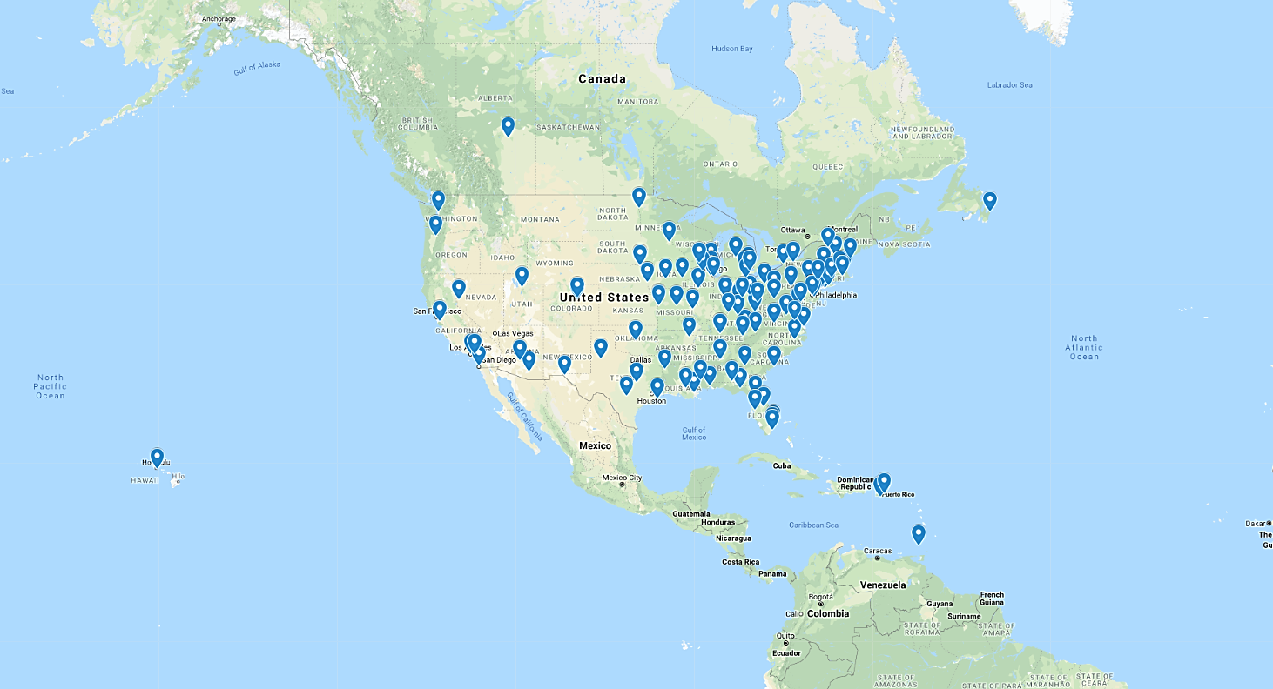
The Gold Humanism Honor Society
160+ chapters
4,000 members inducted/year
35,000 members in training and practice
Inductees:
  Students
  Residents
  Faculty advisors
  Gold Foundation awardees

Slide 7
GHHS – What We Do
National Projects
National Conferences
Regional Conferences
Chapter Projects

Slide 8
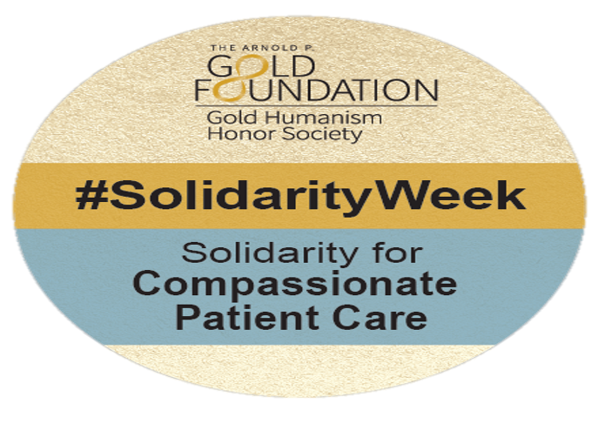
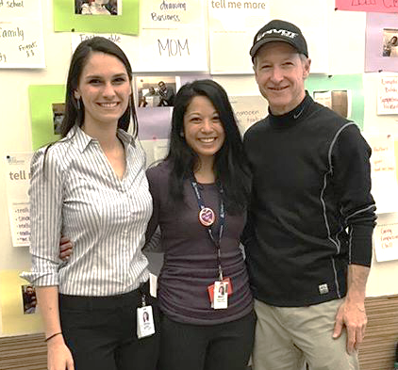
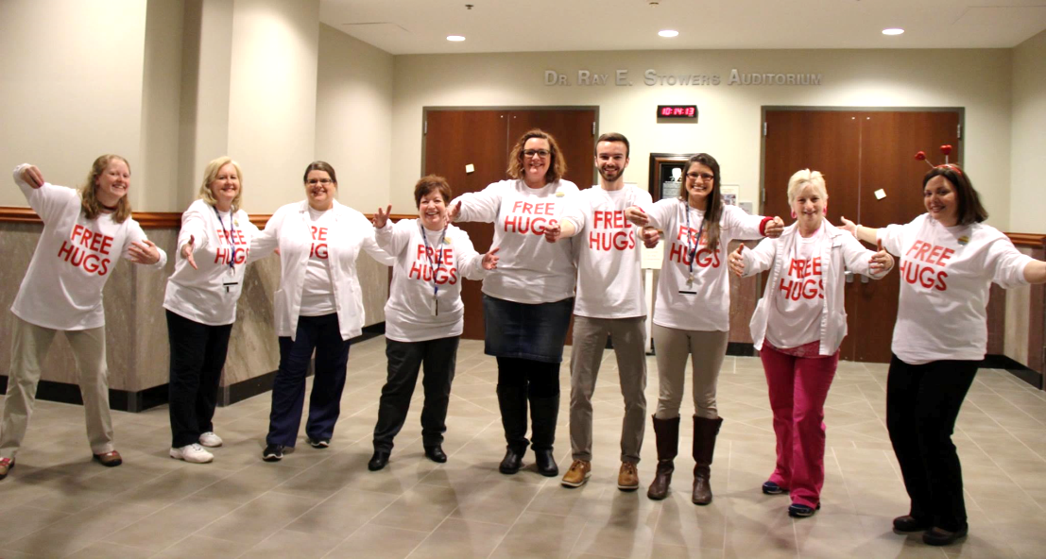
GHHS – National Projects
Solidarity Week for Compassionate Patient Care
Began in 2011
February 10-14, 2020
Annual week of recognition around the county for all GHHS chapters, medical schools, and patient care institutions
87 institutions participated in 2020
The University of Arizona College of Medicine
Lincoln Memorial University-DeBusk College of Osteopathic Medicine
Notes:
As the first trauma surgeon to treat Congresswoman Gabrielle Giffords after she was shot, Dr. Randall Friese struck a chord when he said that his most important actions that terrible day were “holding her hand, speaking to her and reassuring her that she was in the hospital and would be cared for.”
To honor that spirit of caring, the Gold Humanism Honor Society created a National Day of Solidarity for Compassionate Patient Care for medical schools to undertake projects demonstrating the importance of empathy and compassion in patient care.

Slide 9
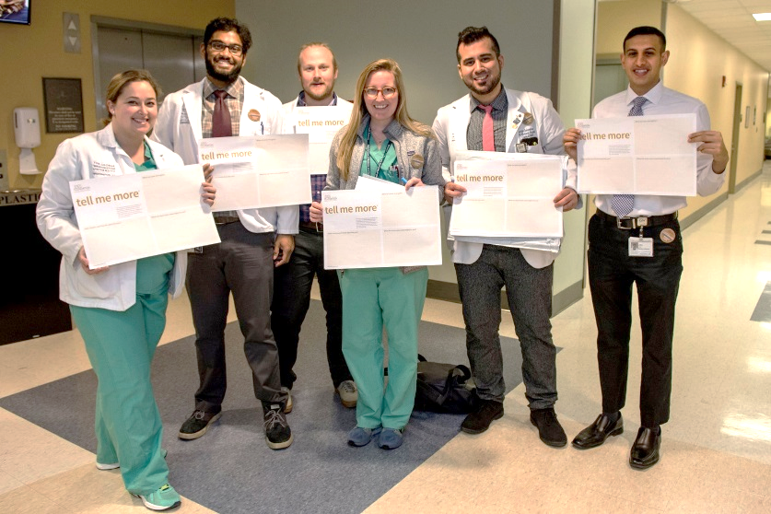

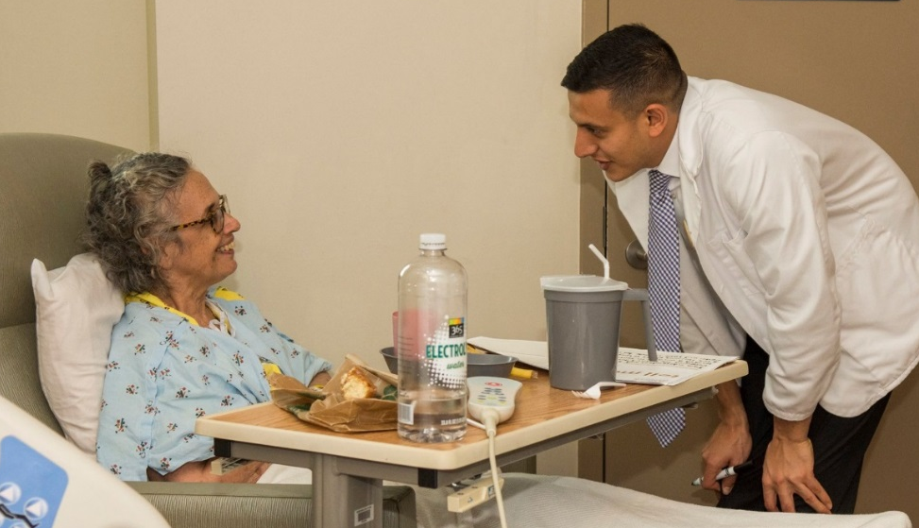
GHHS – National Projects
Tell Me More ®
“ Knowing the patient's story is important to understanding who they are, what their values are, it helps us as doctors to build trust with our patients and deliver better care.... I hope I never lose the sense of excitement and joy I felt today. ”
George Washington School of Medicine and Health Sciences
– Resident
The GW School of Medicine
and Health Sciences
George Washington School of Medicine and Health Sciences
Notes:
One of the Gold Foundation's signature programs is the Tell Me More program, initially developed in 2014 by GHHS chapter members at the Icahn School of Medicine at Mt. Sinai. In 2015, over 85 GHHS chapters and health care facilities throughout the US and Canada participated in this easily implemented project and continue to do so yearly during Solidarity Week, a week of recognition around the country for all GHHS chapters, medical schools, and patient care institutions to celebrate their dedication to ensuring compassionate, patient-centered care.
First implemented in 2014, the goal of Tell Me More® (TMM) is simple: to allow patients, caregivers, and hospital staff to connect with each other on a more human level. It was originally designed by medical students to strengthen the critical bond that exists between people who are patients and the individuals who care for them. TMM allows patients and caregivers to get to know each other beyond their diagnoses and job descriptions.
Staff ask patients 3 questions such as: What are your strengths? How would your friends describe you? What has been most meaningful to you?

Slide 10
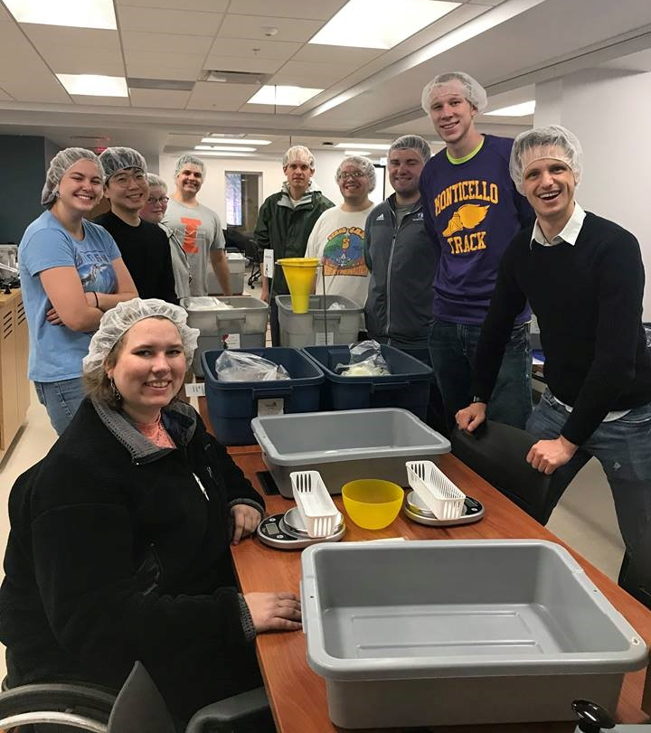


GHHS – National Projects
Disaster Relief
Ponce Health Sciences University was struck by Hurricane Maria in October 2017
The GHHS chapter at the Carle Illinois College of Medicine at the University of Illinois at Urbana-Champaign provided relief:
  177 volunteers packaging over 5,000 packages of rice and rice-soy casseroles
  “The message from Ponce Health Sciences University created a unique opportunity for our College of Medicine community to respond directly to needs as defined by the specific requests of colleagues who are truly ‘on the ground,’ traveling among communities in southern Puerto Rico to distribute supplies and attend to health needs. This underlies the excitement for this project – that it was both direct and responsive.”
  — University of Illinois at Urbana-Champaign GHHS chapter
Packaging shipped from Illinois to Puerto Rico
University of Illinois College of Medicine

Slide 11

GHHS – National Projects
Thank a Resident Day
Began in 2018
February 28, 2020
Encourages students to show their gratitude to the unsung teachers of their medical school clerkships
Developed at the University of Missouri-Kansas City
188 institutions participated in 2020

Slide 12

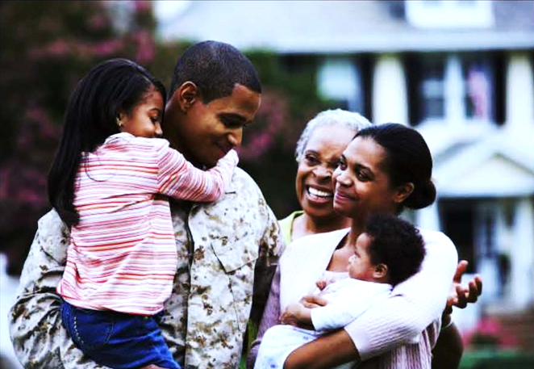
GHHS – National Projects
Veterans Gold Health Initiative
Quality Improvement Project
Address healthcare disparities through the identification of veteran status and associated risk for unique employment-related illnesses

Slide 13
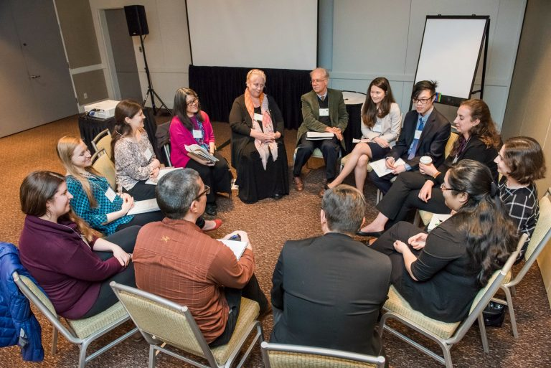
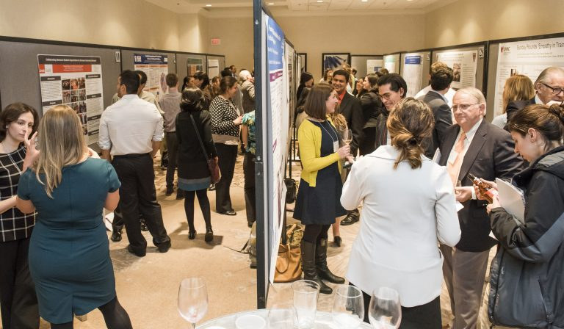
GHHS – National Conferences
National Conference on Humanism
National Conference on Humanism: “Cultivating Resiliency Through Humanism and Community”
Chicago, IL, March 2017
300+ healthcare leaders & students convened
Three-day conference designed to renew strength in participants’ connection with humanism in medicine
National Conference in Chicago, IL
National Conference in Chicago, IL

Slide 14


GHHS – National Conferences
Gold Humanism Summit
The Gold Foundation held its inaugural Gold Humanism Summit at the Planetree International Conference on Patient-Centered Care
Orlando, FL, October 27-30, 2019
200+ healthcare leaders & students convened
The four-day event began with a pre-conference conducted by GHHH students

Slide 15
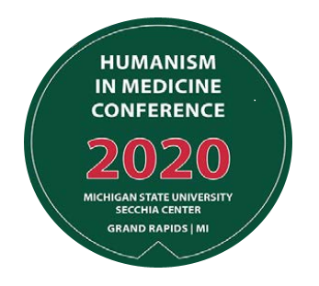
GHHS – Regional Conferences
Humanism in Medicine Conference
Regional conferences are smaller conferences conducted by GHHS chapters throughout the country.
These are ideal events for students to network and connect with others in the community.
Chapters are encouraged to apply for grants from The Gold Foundation to help support these efforts.

Slide 16

GHHS – Regional Conferences
The Invisible Minority: Healthcare Disparities
in Appalachia

Slide 17
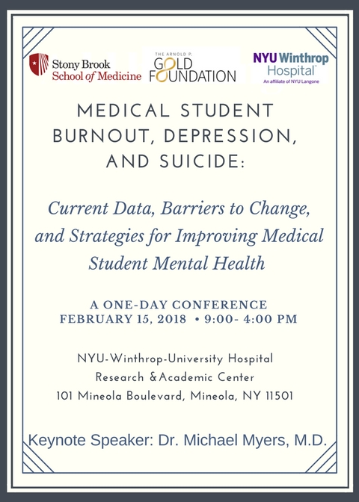
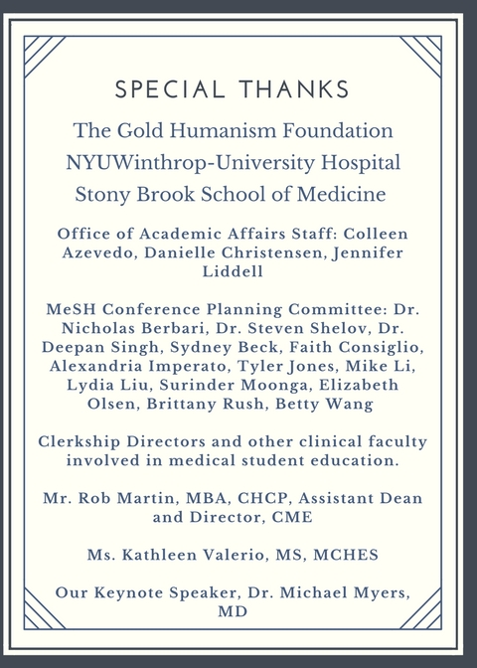
GHHS – Regional Conferences
Medical Student Burnout, Depression, and Suicide

Slide 18







GHHS – Examples of Chapter Projects
The Soul Food Project: Fighting Loneliness
Over Lunch
Beyond Mortality - Improving Intensive Care Unit Survivor
Psychocognitive Morbidity
Chicago Street Medicine
Start-up Initiative
Domestic Violence and Sexual
Assault Survivor Project

Slide 19
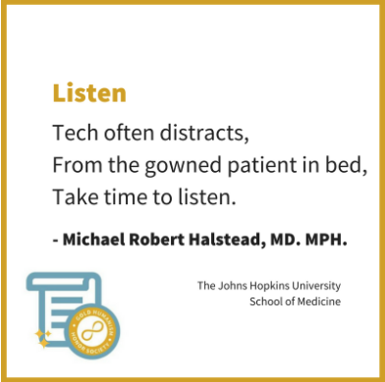

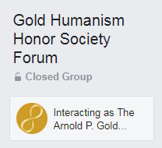

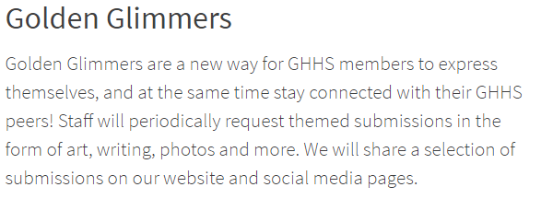
Staying Connected

Slide 20
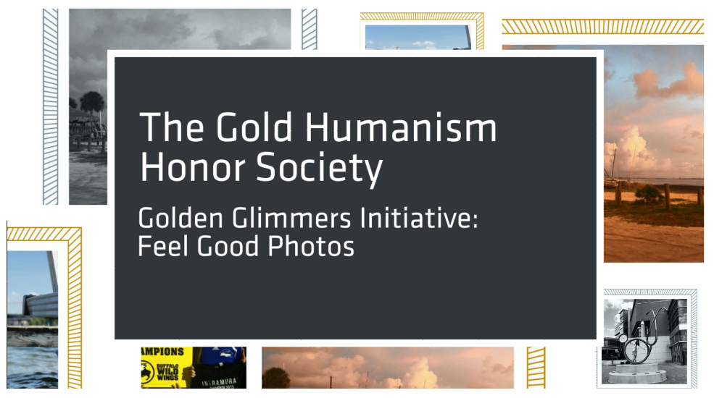
Staying Connected

Slide 21

Staying Connected

Slide 22
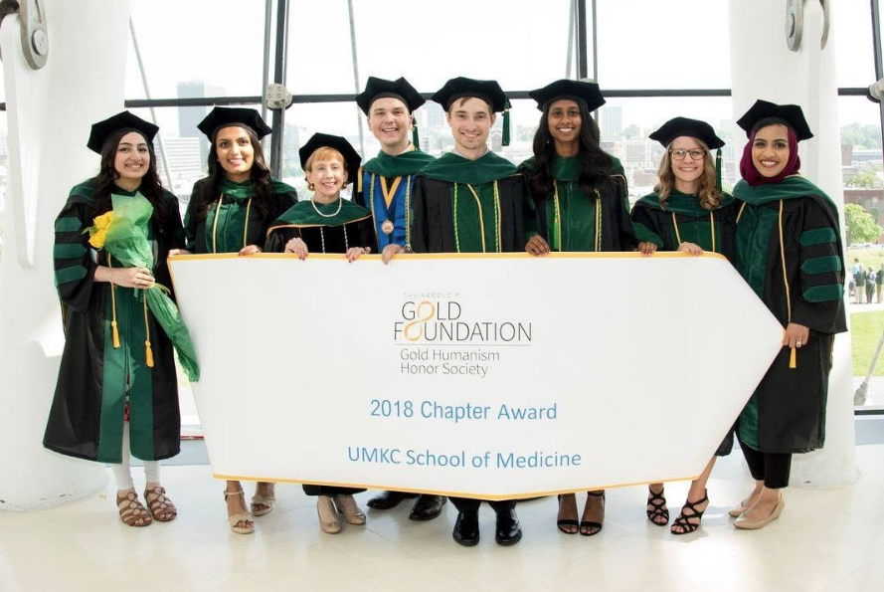
GHHS Chapter Award
The Gold Humanism Honor Society honors outstanding chapters for their impact, leadership and service activities.
Distinguished Chapter Award
The Distinguished Chapter Award is a comprehensive award for a chapter that has shown exceptional impact on its school’s culture.
Trailblazer Awards
These awards are dedicated to the specific efforts of our GHHS community.
Notes:
Please fix the margins so they all align. Change the color of font in the second bullet to stagger the visuals.

Slide 23

Congratulations Inductees!
You’ve been identified as the humanistic exemplars and selected by your peers to represent your class!
Only 10-15 % of your class receive this honor.
Today, you are celebrated and formally recognized in your GHHS induction ceremony.

Slide 24

Inductee names here:
Ceremony date and time

Slide 25
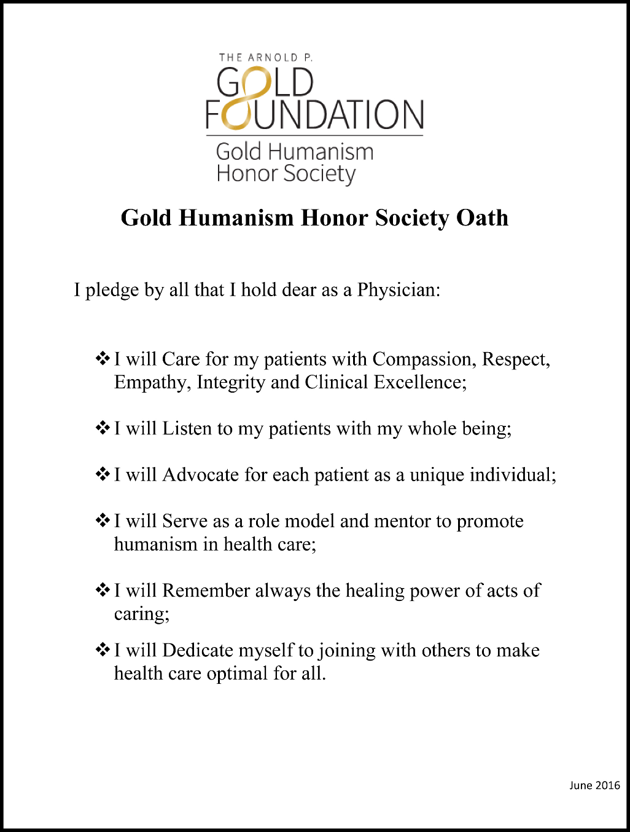
Gold Humanism Honor Society Oath
Please add some language about the oath, how to recite it, why it’s important, etc.

Slide 26
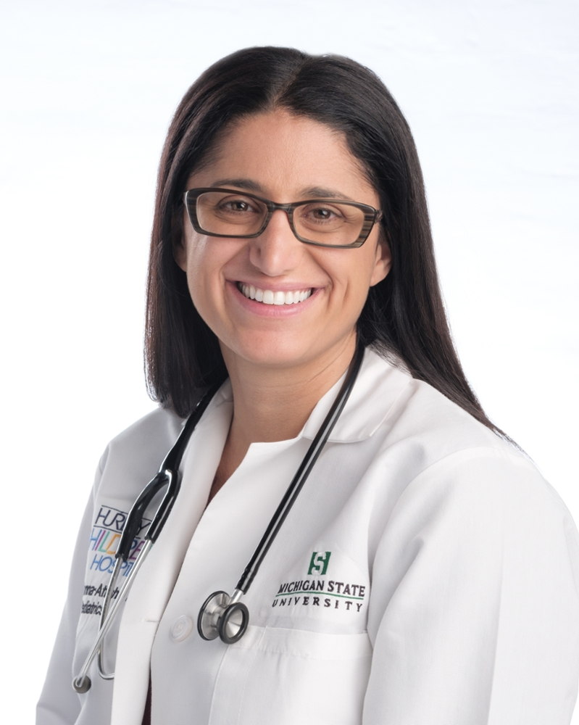
Notable GHHS member
Mona Hanna- Attisha, MD
Inducted in 2010 at Wayne State University School of Medicine
Recognized for her role in exposing the Flint water crisis and her public health advocacy in response
Named Time Magazine’s Most Influential People in 2016
One of the Ten Outstanding Young Americans of 2017

