Slide 1
[your school name]
[Your Ceremony Title]
[ Your school logo ]

Slide 2
History of the Ceremony
The White Coat Ceremony is the oldest, and most well-known, program of the Gold Foundation. The Arnold P. Gold Foundation established the White Coat Ceremony in 1993 at the Columbia University Vagelos College of Physicians & Surgeons as a way to emphasize humanism in medicine at the very start of medical education.
In 2014, recognizing the vital role nurses play in the healthcare team, the Gold Foundation partnered with the American Association of Colleges of Nursing to adapt the ceremony for nursing.
While it may take different forms, the ceremony emphasizes the importance of humanistic patient care, defined as compassionate, collaborative and scientifically excellent healthcare, early in nursing training and professional identity formation.
More than 450 schools of nursing have participated and the number continues to grow.

Slide 3
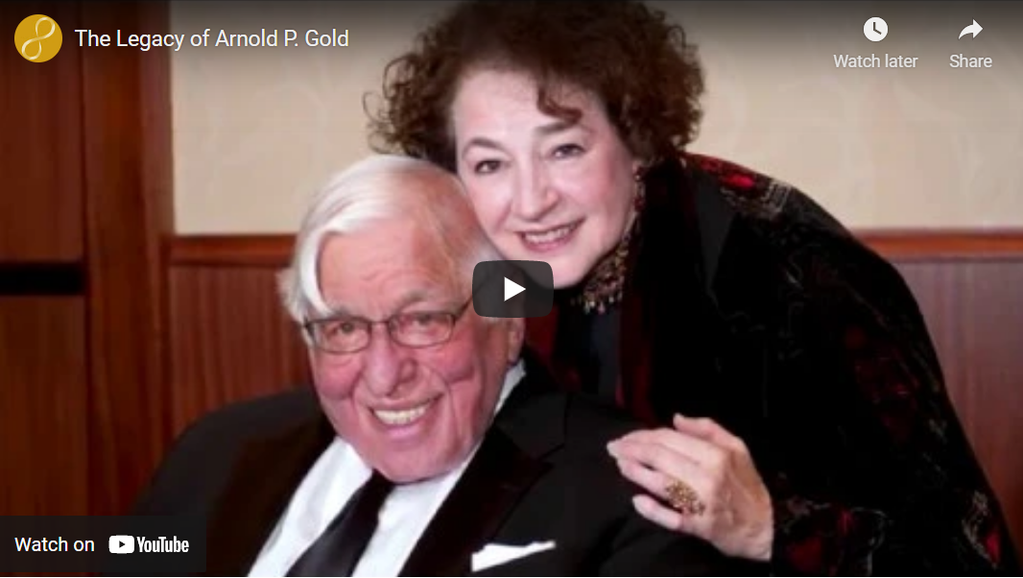
“The Legacy of Arnold P. Gold”
http://www.gold-foundation.org/newsroom/video/the-legacy-of-arnold-p-gold/

Slide 4
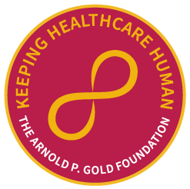
Pinning
[ Student Photo ]
[ Student Name ]
[Use this slide to recognize students individually]

Slide 5
Pinning
[ Student Name ]
[ Student Name ]
[Use this slide to recognize students as a group]

Slide 6
Pledge or Oath
[For example pledges and oaths, including a version of the Nightingale Pledge and those written by faculty or students at other nursing schools, visit: https://gold-foundation.s3.amazonaws.com/wp-content/uploads/2022/06/Nursing-Pledge-and-Oath-Examples.pdf

Slide 7
Social Media
Celebrate your ceremony by sharing your photos & thoughts!
Mention @Your School Name and @GoldFdtn on Twitter or Instagram.

