Slide 1
[your school name]
[Your Ceremony Title]
[ Your school logo ]

Slide 2
History of the Ceremony
The White Coat Ceremony is the oldest, and most well-known, program of the Gold Foundation. The Arnold P. Gold Foundation established the White Coat Ceremony in 1993 at the Columbia University Vagelos College of Physicians & Surgeons as a way to emphasize humanism in medicine at the very start of medical education.
Since then, numerous health profession schools including pharmacy and nursing have held white coat ceremonies and while it may take different forms, the ceremony continues to emphasize the importance of humanistic patient care, defined as compassionate, collaborative and scientifically excellent healthcare, early in training and professional identity formation.

Slide 3
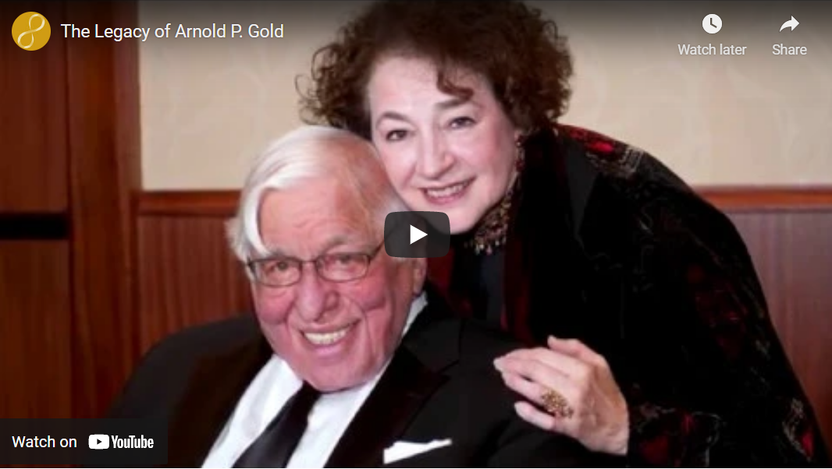
“The Legacy of Arnold P. Gold”
http://www.gold-foundation.org/newsroom/video/the-legacy-of-arnold-p-gold/

Slide 4
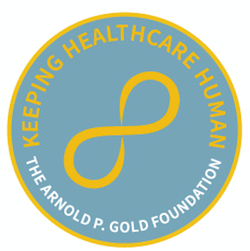
Pinning
[ Student Photo ]
[ Student Name ]
[Use this slide to recognize students individually]

Slide 5
Pinning
[ Student Name ]
[ Student Name ]
[Use this slide to recognize students as a group]

Slide 6
Oath

Slide 7
Social Media
Celebrate your ceremony by sharing your photos & thoughts!
Mention @Your School Name and @GoldFdtn on Twitter or Instagram.

