Slide 1

Empathy in Practice: Countering Assumptions, Advancing Exceptional Care
In collaboration with The Empathy Project, The Office of Professional Development, The Institute for Excellence in Health Equity, and Narrative 4

Slide 2
Learning objectives
By the end of this lecture, you will be able to:
Recognize the impact of an individual’s lived experience on the clinical encounter.
Identify behaviors perceived as aligned with implicit bias and empathy.
Develop strategies to recognize and mitigate implicit bias in clinical settings.
Understand the use of empathy as a tool to improve patient outcomes and clinician wellness.
Practice perspective-getting and believing.

Slide 3



The Elephant in the Waiting Room Collaboration
Created in partnership with over 100 medical and creative professionals, patients, students and researchers, The Elephant in the Waiting Room addresses implicit bias in medicine.
Institute for Excellence in Health Equity
The Office of Professional Development

Slide 4
Agenda
Objectives
Workshop Expectations
Icebreaker
The Elephant in the Waiting Room
Wrap Up

Slide 5

Workshop Expectations
Accept that we have all something to learn and something to contribute
Engage fully in today’s session
Take the message, leave the story
Make space, take space
Assume the best intentions of everyone here today (including yourself)

Slide 6

Please share your name
Think of a person in your life who you'd identify as either empathetic or not empathetic. What makes you feel this way about them?
ICEBREAKER

Slide 7

The Elephant in the Waiting Room
Empathyproject.com
@NYUEmpathy

Slide 8
Implicit Bias
Implicit bias refers to unconscious and unintentional mental
associations that impact our understanding and actions.
Implicit bias recognition and management [IBRM] is our behavioral, skills-based approach to addressing implicit bias in interpersonal encounters.
Cristina M. Gonzalez, Monica L. Lypson & Javeed Sukhera (2021) Twelve tips for teaching implicit bias recognition and management, Medical Teacher, 43:12, 1368-1373, DOI: 10.1080/0142159X.2021.1879378

Slide 9
Implicit bias contributes to healthcare disparities
Clinicians with higher implicit racial bias:
Demonstrate verbal dominance [1]
Have lower patient affect scores and poorer ratings of interpersonal care [1]
Patients who experience implicit racial bias from clinicians:
Have greater difficulty remembering information from the encounter [2]
Negative health effects, include delaying or avoiding medical care and decreased adherence to treatment plans [3]
1. Cooper LA, Roter DL, Carson KA, et al. The associations of clinicians' implicit attitudes about race with medical visit communication and patient ratings of interpersonal care. American journal of public health. 2012;102(5):979-987.
2. Penner LA, Dovidio JF, Gonzalez R, et al. The Effects of Oncologist Implicit Racial Bias in Racially Discordant Oncology Interactions. J Clin Oncol. 2016;34(24):2874-2880.
3. Street RL, Jr., Makoul G, Arora NK, Epstein RM. How does communication heal? Pathways linking clinician-patient communication to health outcomes. Patient Educ Couns. 2009;74(3):295-301.

Slide 10
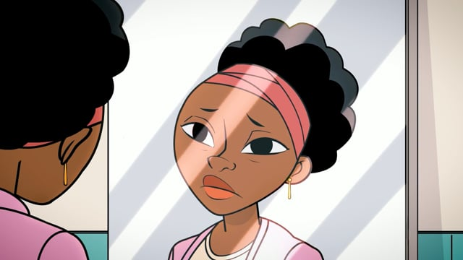

Slide 11
Previous Treatment Experiences
Patient Perspectives on Racial and Ethnic Implicit Bias in Clinical Encounters
Societal Level Factors:
Ubiquitous nature of bias
Privilege (or lack of)
Social determinants of health
Patient Level Factors:
Patient’s degree of empowerment
Language limitations
Mistrust
Delays in care
Avoidance of future care
Physician Behaviors
Health Care System Level Factors:
Language barriers
Non-MD interactions
Bias ignored or dismissed by physician
Present
Bias recognized and acknowledged by physician
Patient lived experience
Perception of bias in medical encounter
Absent
Continued engagement in care
Increased trust in physician
Gonzalez CM, et al.Patient Education and Counseling. 2018;101:1669-75.
Notes:
Reminder: from the beginning of the year in the Empathy Project session

Slide 12
BIAS Mapping

Slide 13
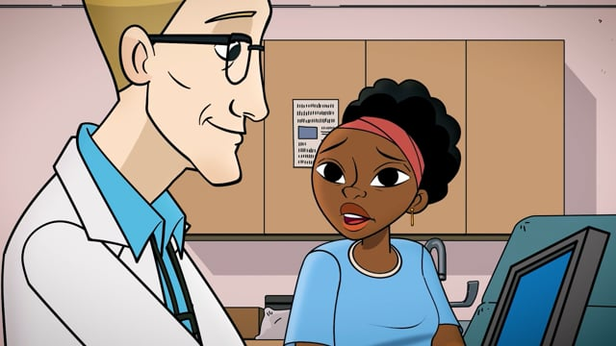

Slide 14
em·pa·thy
/ˈempəTHē/
noun
1. the practice of authentically trying to understand another person's lived experience through communication, and, more specifically, through engaged curiosity.

Slide 15
The benefits of empathy in a clinical setting
Clinicians who practice empathy:
Experience increased satisfaction with their work, decreased stress, and a stronger connection to patients and colleagues.[1] [2]
Contribute to reducing bias by breaking down barriers created by social norms and systemic factors.[3]
Patients who experience empathy from clinicians:
Have more favorable health outcomes as they have increased satisfaction with their care, adhere to treatment more closely, and are likely to be a partner in their medical decisions.[4]
1.Giulia Lamiani, PhD,Paola Dordoni, PhD, Elena Vegni, PsyD, Isabella Barajon Caring for Critically Ill Patients: Clinicians’ Empathy Promotes Job Satisfaction and Does Not Predict Moral Distress Frontiers in Psychology 2020 Jan 8. doi: 10.3389/fpsyg.2019.02902
2.Jean Decety, Ph.D. and Aikaterini Fotopoulou, PhD Why empathy has a beneficial impact on others in medicine: unifying theories Frontiers in Behavioral Neuroscience 2015 Jan 14. doi: 10.3389/fnbeh.2014.00457
3.Brian D. Schwartz, PhD, Alexis Horst, MA, Jenifer A. Fisher, MLIS, Fostering Empathy, Implicit Bias Mitigation, and Compassionate Behavior in a Medical Humanities Course, International Journal of Environmental Research and Public Health 2020 Mar 25. doi: 10.3390/ijerph17072169
4. Helen Reiss, MD, Gordon Kraft-Todd, MD, E.M.P.A.T.H.Y. Academic Medicine: August 2014 – Volume 89 – Issue 8 - p 1108-1112

Slide 16
Skills for Increasing Empathy
Engaged curiosity – a genuine, active, and open interest in understanding the experiences, perspectives, and needs of others
Active listening – being present for the content and emotion of what is being communicated, without interruption
Perspective getting/believing – acknowledging a person’s lived experience without internalizing or judgement
Self-awareness – an understanding or critical assessment of one's emotions, biases, and perspectives and the role one plays within an interaction

Slide 17
Reflect on Dr. Gunderson's interaction with Ms. Ouologuem. How could Dr. Gunderson have changed his behavior and recognized his bias?
Consider how empathy and perspective-getting/ believing are important clinical skills for implicit bias recognition and management (IBRM).
REFLECTION

Slide 18
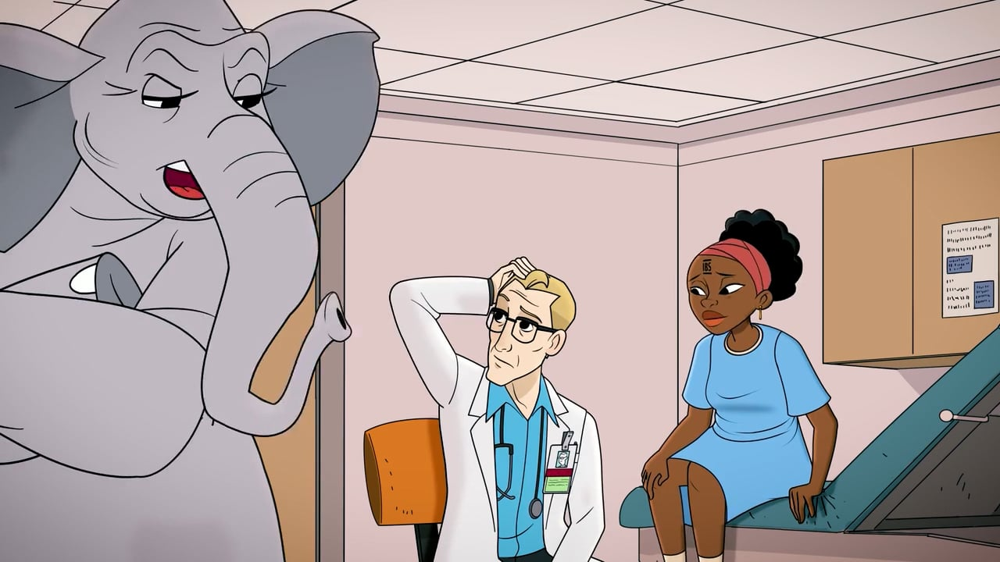
To see the full film: EmpathyProject.com

Slide 19
How could Dr. Gunderson have changed his behavior and recognized his bias?
Brainstorm how empathy and perspective-getting are important clinical skills for mitigating bias.
DISCUSSION

Slide 20
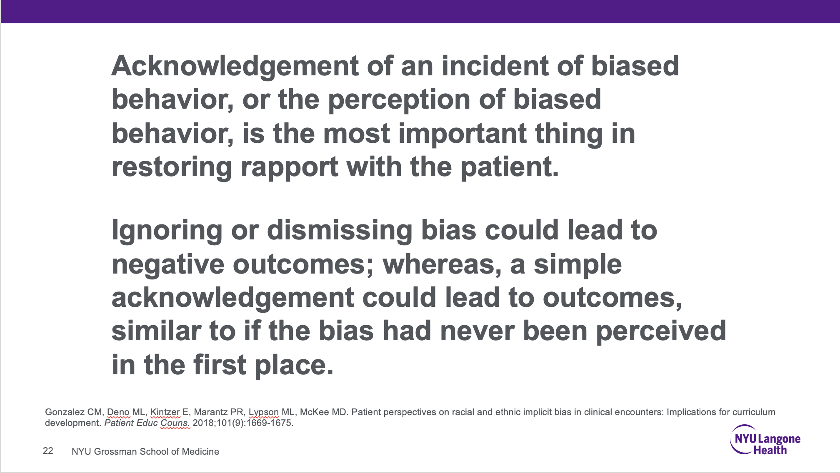

Slide 21

PEARLS
Partnership
Empathy*
Apology
Respect
Legitimization
Support

Slide 22
Important Take-Aways
Patients' lived experiences may lead to perceived bias in a clinical encounter.
Perspective-getting is one skill important to both empathy and implicit bias recognition and management (IBRM).
Acknowledging perceived (or actual) bias is an important skill in IBRM to restore rapport.
The use of empathy is a vital skill that enhances patient outcomes and promotes physician wellness—the very goals we are all striving to achieve.

Slide 23
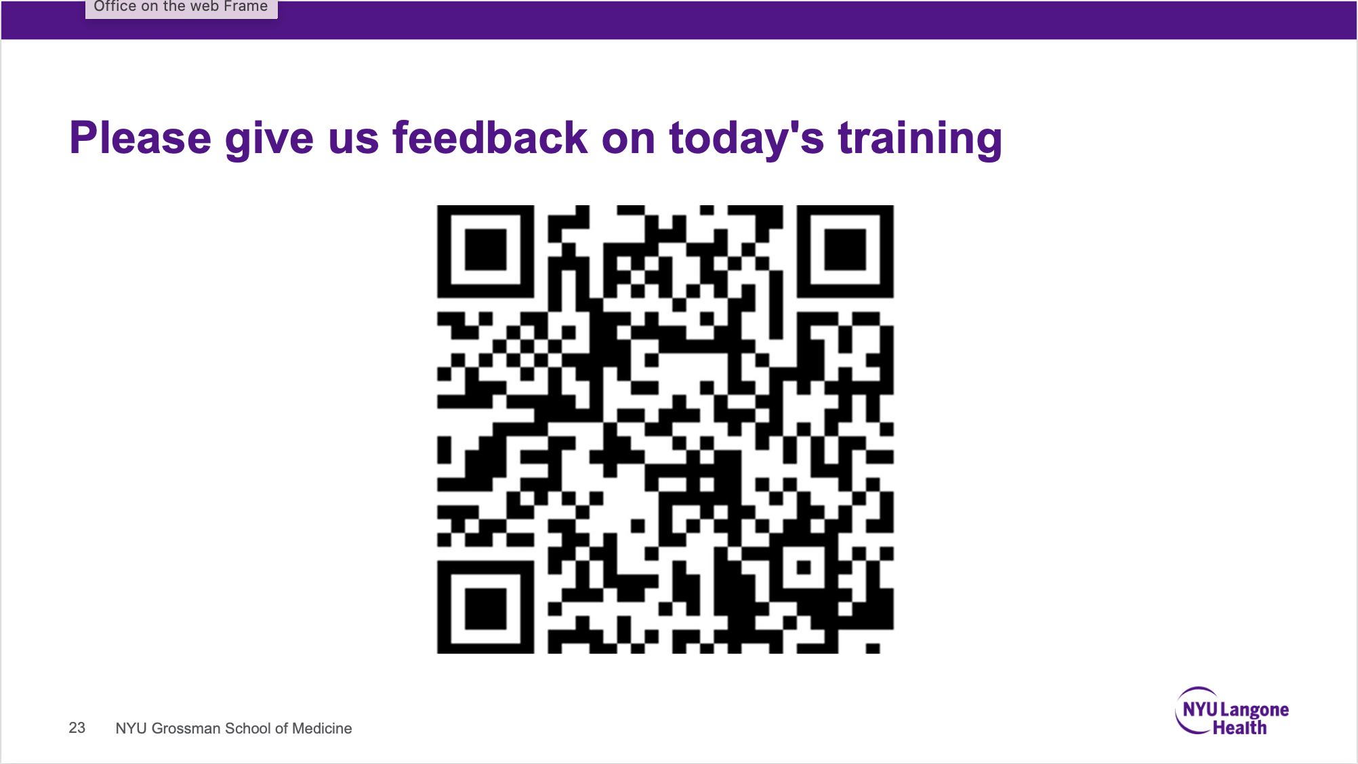

Slide 24

Empathyproject.com
@NYUEmpathy

Slide 25
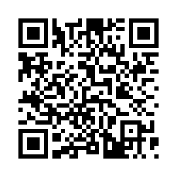
FOR FACILITATORS:
INTAKE/ACTIVITY TRACKER SURVEY
This document must be completed by those facilitating
The Empathy Project curricular and training activities each time
Link to enter data: https://nyumc.qualtrics.com/jfe/form/SV_bwOKvfyUZtoBKHI
Or, QR Code

