Slide 1
[your school name]
White Coat Ceremony
[ Your school logo ]

Slide 2
History of the
White Coat Ceremony
Dr. Arnold P. Gold, a pediatric neurologist, wanted to ensure that future healthcare professionals took an oath to compassionate patient care early in their training, rather than waiting until graduation. He envisioned the White Coat Ceremony as a ritual to emphasize the importance of humanism in healthcare early in training. The first such White Coat Ceremony was held in 1993. Since then, the Gold Foundation has spread the meaningful ceremony around the world.
Dr. Gold believed the human connection is essential to the best care. Studies show connection improves patient care and clinician well-being. Everyone benefits.

Slide 3
History of the
White Coat Ceremony
Today, virtually all U.S. allopathic (MD) and osteopathic (DO) medical schools hold a White Coat Ceremony, along with many medical schools around the globe.
In 2014, recognizing the vital role nurses play in healthcare, the Gold Foundation partnered with the American Association of Colleges of Nursing to adopt a White Coat Ceremony for Nursing. More than 450 nursing schools have participated.
In total, the Gold Foundation distributes about 50,000 pins for free each year to support White Coat Ceremonies.

Slide 4
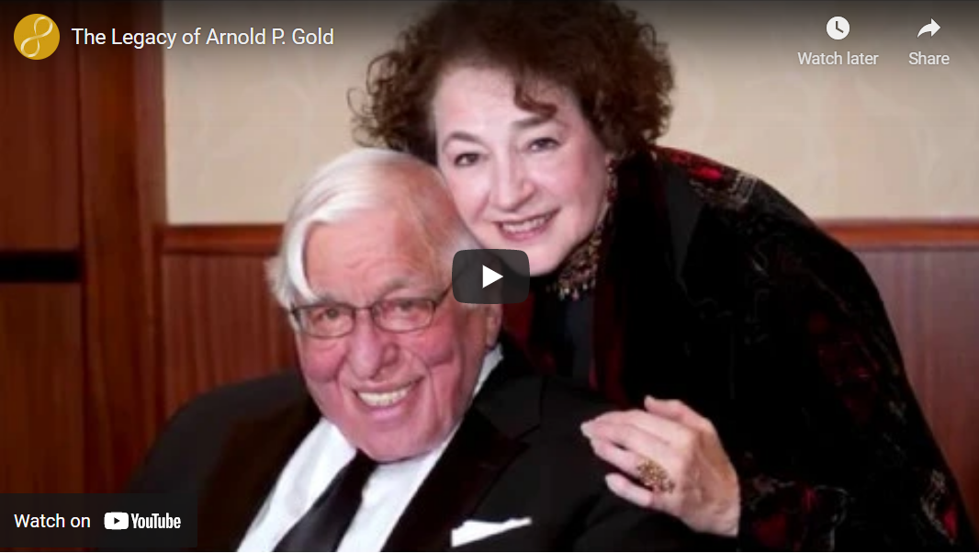
“The Legacy of Arnold P. Gold”
http://www.gold-foundation.org/newsroom/video/the-legacy-of-arnold-p-gold/

Slide 5
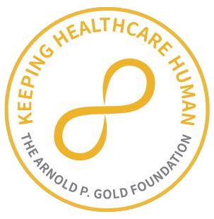
Pinning Ceremony
[ Student Photo ]
[ Student Name ]
[Use this slide to recognize students individually]

Slide 6
Pinning Ceremony
[ Student Name ]
[ Student Name ]
[Use this slide to recognize students as a group]

Slide 7
Oath

Slide 8
Social Media
Celebrate your White Coat Ceremony
by sharing your photos!
Tag @Your School Name and @GoldFdtn
on Instagram.

